Slide 1
UNIT-I

Slide 2
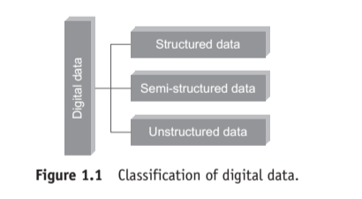
Classification of Digital Data

Slide 3
1. Unstructured data:
This is the data which does not conform to a data model or is not in a form which can be used easily by a computer program.
About 80–90% data of an organization is in this format; for example, memos, chat rooms, PowerPoint presentations, images, videos, letters, researches, white papers, body of an email, etc.

Slide 4
2. Semi-structured data:
This is the data which does not conform to a data model but has some structure. However, it is not in a form which can be used easily by a computer program;
for example, emails, XML, markup languages like HTML, etc. Metadata for this data is available but is not sufficient.

Slide 5
3. Structured data:
This is the data which is in an organized form (e.g., in rows and columns) and can be easily used by a computer program. Relationships exist between entities of data, such as classes and their objects. Data stored in databases is an example of structured data.

Slide 6
We have grown comfortable working with RDBMS – the storage, retrieval, and management of data has been immensely simplified. The data held in RDBMS is typically structured data.

Slide 7
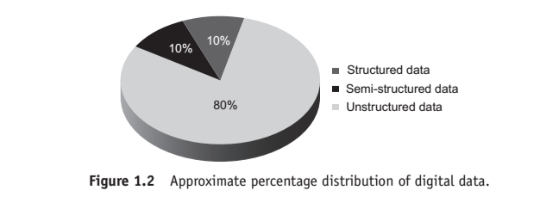

Slide 8
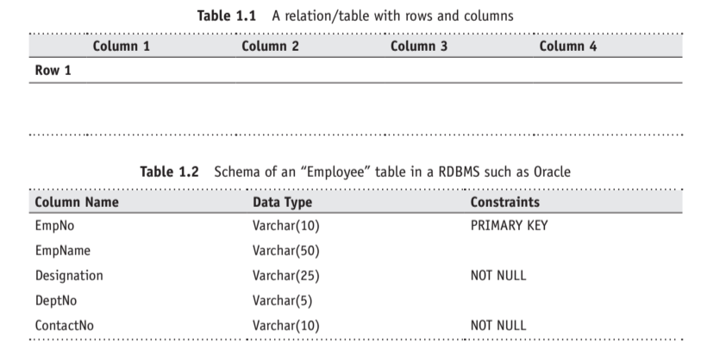

Slide 9
Sources of Structured Data
If your data is highly structured, one can look at leveraging any of the available RDBMS [Oracle Corp. – Oracle, IBM – DB2, Microsoft – Microsoft SQL Server, EMC – Greenplum, Teradata – Teradata, MySQL (open source), PostgreSQL (advanced open source), etc.] to house it.
These databases are typically used to hold transaction/operational data generated and collected by day-to-day business activities. In other words, the data of the On-Line Transaction Processing (OLTP) systems are generally quite structured.

Slide 10
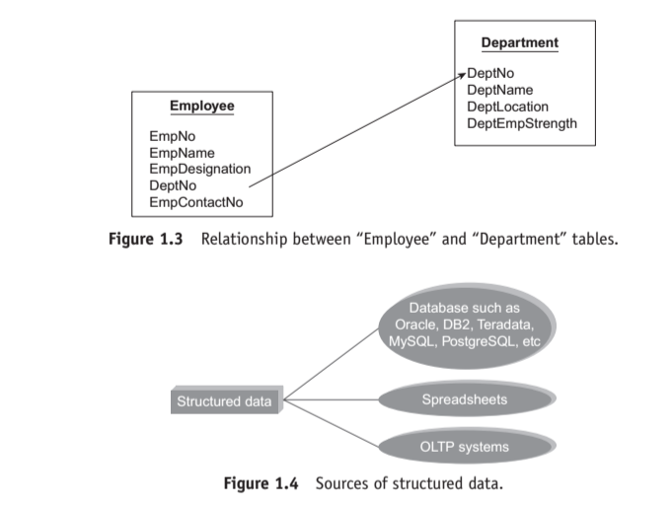

Slide 11
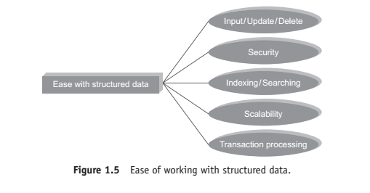
Ease of Working with Structured Data

Slide 12
Ease of Working with Structured Data
Structured data provides the ease of working with it..The ease is with respect to the following:
1. Insert/update/delete:
The Data Manipulation Language (DML) operations provide the required ease with data input, storage, access, process, analysis, etc.

Slide 13
2. Security:
How does one ensure the security of information?
There are available staunch encryption and tokenization solutions to warrant the security of information throughout its lifecycle.

Slide 14
Organizations are able to retain control and maintain compliance adherence by ensuring that only authorized individuals are able to decrypt and view sensitive information.

Slide 15
3. Indexing:
An index is a data structure that speeds up the data retrieval operations (primarily the SELECT DML statement) at the cost of additional writes and storage space, but the benefits that ensue in search operation are worth the additional writes and storage space.

Slide 16
4. Scalability:
The storage and processing capabilities of the traditional RDBMS can be easily scaled up by increasing the horsepower of the database server (increasing the primary and secondary or peripheral storage capacity, processing capacity of the processor, etc.).

Slide 17
5. Transaction processing:
RDBMS has support for Atomicity, Consistency, Isolation, and Durability (ACID) properties of transaction. Given next is a quick explanation of the ACID properties:

Slide 18
Atomicity:
A transaction is atomic, means that either it happens in its entirety or none of it at all.

Slide 19
Consistency:
• The database moves from one consistent state to another consistent state. In other words, if the same piece of information is stored at two or more places, they are in complete agreement.

Slide 20
• Isolation:
The resource allocation to the transaction happens such that the transaction gets the impression that it is the only transaction happening in isolation.

Slide 21
Durability:
All changes made to the database during a transaction are permanent and that accounts for the durability of the transaction.

Slide 22
1.1.2 Semi-Structured Data
Semi-structured data is also referred to as self-describing structure.
It has the following features:
1. It does not conform to the data models that one typically associates with relational databases or any other form of data tables.

Slide 23
2. It uses tags to segregate semantic elements.
3. Tags are also used to enforce hierarchies of records and fields within data.

Slide 24
4. There is no separation between the data and the schema. The amount of structure used is dictated by the purpose at hand

Slide 25
5. In semi-structured data, entities belonging to the same class and also grouped together need not necessarily have the same set of attributes.

Slide 26
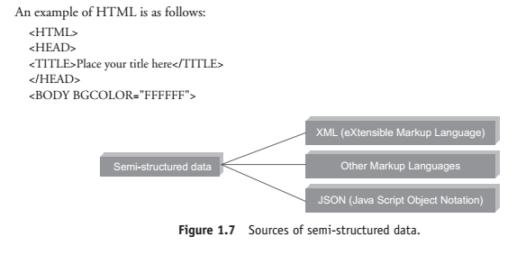
Sources of Semi-Structured Data

Slide 27
Sources of Semi-Structured Data
. 1. XML: eXtensible Markup Language (XML) is hugely popularized by web services developed utilizing the Simple Object Access Protocol (SOAP) principles.

Slide 28
2. JSON: Java Script Object Notation (JSON) is used to transmit data between a server and a web application.

Slide 29
JSON is popularized by web services developed utilizing the Representational State Transfer (REST) – an architecture style for creating scalable web services.

Slide 30
MongoDB (open-source, distributed, NoSQL, documented-oriented database) and Couchbase (originally known as Membase, open-source, distributed, NoSQL, document-oriented database) store data natively in JSON format.

Slide 31
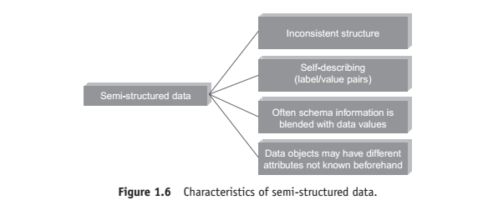
Characteristics of Semi-structured data

Slide 32
Unstructured Data
Unstructured data does not conform to any pre-defined data model.

Slide 33
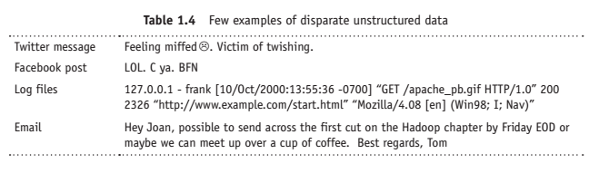
the structure is quite unpredictable. (Example of Unstructured Data)

Slide 34
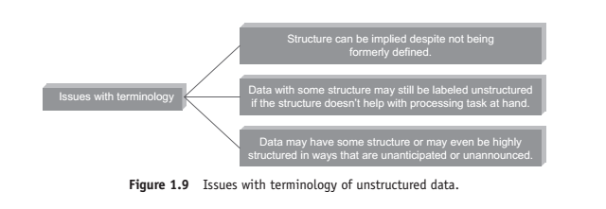
Issues with “Unstructured” Data

Slide 35
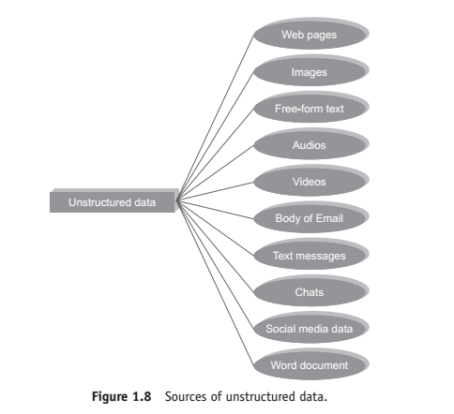
Sources of Unstructured Data

Slide 36
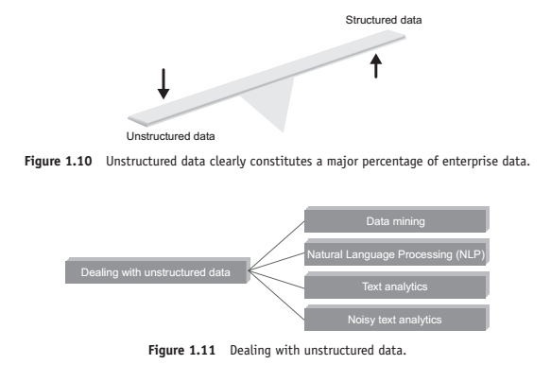
Dealing with Unstructured Data

Slide 37
Techniques are used to find patterns in or interpret unstructured data:
1. Data mining
2. Text analytics or text mining
3. Natural language processing (NLP)
4. Noisy text analytics
5. Manual tagging with metadata
6. Part-of-speech tagging
7. Unstructured Information Management Architecture (UIMA)

Slide 38
1. Data mining
It is the analysis step of the “knowledge discovery in databases” process.
Few popular data mining algorithms are as follows:
1. Association rule mining
2. Regression analysis
3. Collaborative filtering

Slide 39
a. Association rule mining
It is also called “market basket analysis” or “affinity analysis”.
It is used to determine “What goes with what?”
It is about when you buy a product, what is the other product that you are likely to purchase with it.

Slide 40
Example
If you pick up bread from the grocery, are you likely to pick eggs or cheese to go with it.

Slide 41
b. Regression analysis
It helps to predict the relationship between two variables.
The variable whose value needs to be predicted is called the dependent variable and the variables which are used to predict the value are referred to as the independent variables.

Slide 42
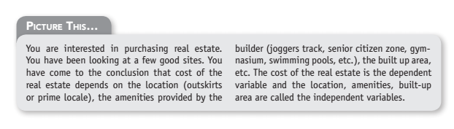

Slide 43
c. Collaborative filtering
It is about predicting a user’s preference or preferences based on the preferences of a group of users.

Slide 44
For example, take a look at Table 1.5. We are looking at predicting whether User 4 will prefer to learn using videos or is a textual learner depending on one or a couple of his or her known preferences.

Slide 45
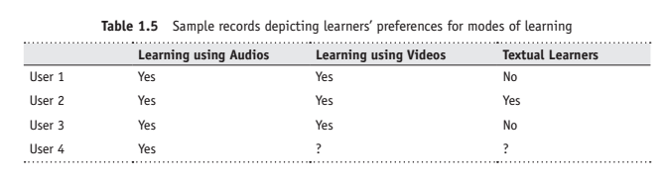

Slide 46
We analyze the preferences of similar user profiles and on the basis of it, predict that User 4 will also like to learn using videos and is not a textual learner.

Slide 47
2. Text analytics or text mining:
Text mining is the process of gleaning high quality and meaningful information (through devising of patterns and trends by means of statistical pattern learning) from text.

Slide 48
It includes tasks such as text categorization, text clustering, sentiment analysis, concept/entity extraction, etc.

Slide 49
3. Natural language processing (NLP)
It is related to the area of human computer interaction.
It is about enabling computers to understand human or natural language input.

Slide 50
4. Noisy text analytics:
It is the process of extracting structured or semi-structured information from noisy unstructured data such as chats, blogs, wikis, emails, message-boards, text messages, etc.

Slide 51
The noisy unstructured data usually comprises one or more of the following:
Spelling mistakes,
abbreviations, acronyms,
non-standard words, missing punctuation,
missing letter case,
filler words such as “uh”, “um”, etc.

Slide 52
5. Manual tagging with metadata
This is about tagging manually with adequate metadata to provide the requisite semantics to understand unstructured data.

Slide 53
6. Part-of-speech tagging
It is also called POS or POST or grammatical tagging.
It is the process of reading text and tagging each word in the sentence as belonging to a particular part of speech such as “noun”, “verb”, “adjective”, etc.

Slide 54
7. Unstructured Information Management Architecture (UIMA)
It is an open source platform from IBM.
It is used for real-time content analytics.
It is about processing text and other unstructured data to find latent meaning and relevant relationship buried therein.
Read up more on UIMA at the link: http://www.ibm.com/developerworks/data/downloads/uima/

Slide 55
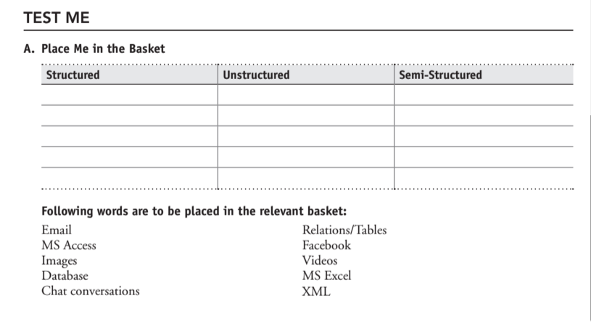

Slide 56
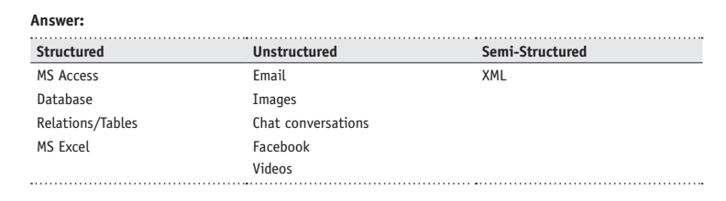

Slide 57
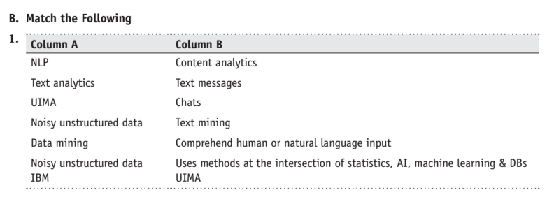

Slide 58
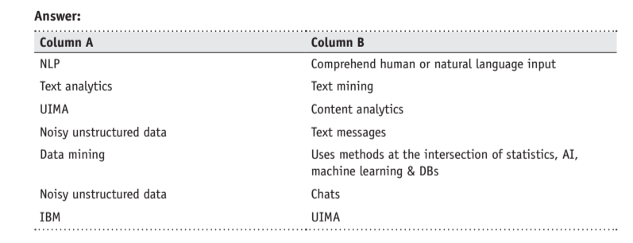

Slide 59
1. Why is an email placed in the “unstructured category”?

Slide 60
Answer: Let us take a look at what we can place in the body of the email.
We can have any or more of the following:
• Hyperlink
• PDFs/DOCs/XLS/etc. attachments
• Emoticons
• Images
• Audio/video attachments
• Free flowing text, etc.
The above are reasons behind placing the email in the “unstructured category”.

Slide 61
2. What category will you place a CCTV footage into?

Slide 62
Answer: Unstructured

Slide 63
3. You have just got a book issued from the library.
What are the details about the book that can be placed in an RDBMS table?

Slide 64
Answer:
Title of the book
Author of the book .
Publisher of the book
Year of Publication
No. of pages in the book
Type of book such as whether hardbound or paperback
Price of the book
ISBN No. of the book
Attachments such as With CD or Without CD, etc.

Slide 65
4. Which category would you place the consumer complaints and feedback?

Slide 66
Answer: Unstructured data

Slide 67
CHARACTERISTICS OF DATA
Data has three key characteristics:
1. Composition
2. Condition
3. Context

Slide 68
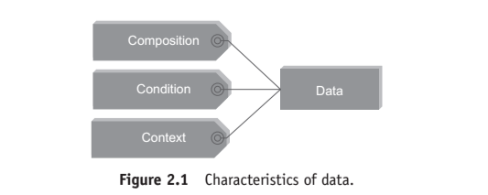

Slide 69
1. Composition
The composition of data deals with the structure of data, that is, the sources of data, the granularity, the types, and the nature of data as to whether it is static or real-time streaming.

Slide 70
2. Condition:
The condition of data deals with the state of data, that is, “Can one use this data as is for analysis?” or “Does it require cleansing for further enhancement and enrichment?”

Slide 71
3. Context
The context of data deals with “Where has this data been generated?” “Why was this data generated?” “How sensitive is this data?” “What are the events associated with this data?” and so on.

Slide 72
2.2 EVOLUTION OF BIG DATA
1970s and before was the era of mainframes. The data was essentially primitive and structured.
Relational databases evolved in 1980s and 1990s. The era was of data intensive applications.

Slide 73
The World Wide Web (WWW) and the Internet of Things (IoT) have led to an onslaught of structured, unstructured, and multimedia data.

Slide 74
2.3 DEFINITION OF BIG DATA
Well, we will give you a few responses that we have heard over time:
1. Anything beyond the human and technical infrastructure needed to support storage, processing, and analysis.

Slide 75
2. Today’s BIG may be tomorrow’s NORMAL.
3. Terabytes or petabytes or zettabytes of data.
4. I think it is about 3 Vs.

Slide 76
Big data definition
Big data is high-volume, high-velocity, and high-variety information assets that demand cost effective, innovative forms of information processing for enhanced insight and decision making.

Slide 77
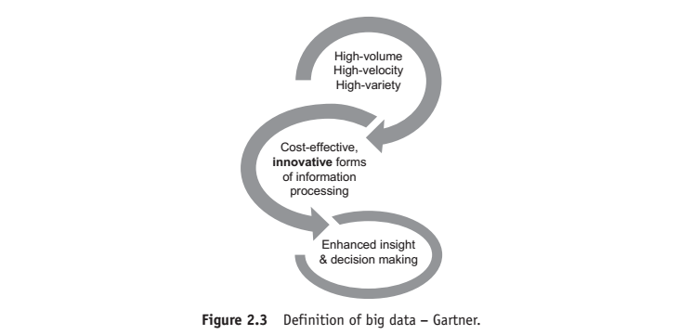

Slide 78
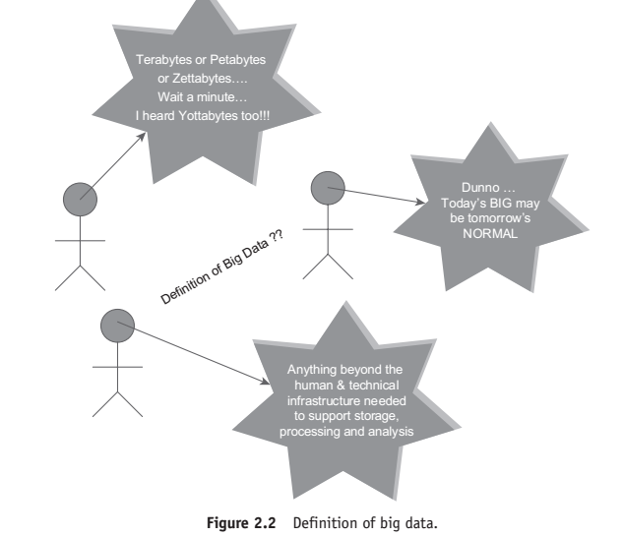

Slide 79
Part I of the definition
“big data is high-volume, high-velocity, and high-variety information assets” talks about voluminous data (humongous data) that may have great variety (a good mix of structured, semi-structured, and unstructured data)
and will require a good speed/pace for storage, preparation, processing, and analysis.

Slide 80
Part II of the definition
“cost effective, innovative forms of information processing” talks about embracing new techniques and technologies to capture (ingest), store, process, persist, integrate, and visualize the high-volume, high-velocity, and high-variety data.

Slide 81
Part III of the definition
“enhanced insight and decision making” talks about deriving deeper, richer, and meaningful insights and then using these insights to make faster and better decisions to gain business value and thus a competitive edge.

Slide 82
Data → Information → Actionable intelligence → Better decisions → Enhanced business value

